Slide 1
Patch Barracks- Gates
& traffic routes during the gate improvement project
LTC Daniel Jimenez / DES / DSN 314-596-3001 / daniel.jimenez6.mil@army.mil

Slide 2
USAG Stuttgart: Gate Construction Projects
Project: In compliance with Unified Facility Criteria requirements, USAG Stuttgart will enhance security posture by upgrading existing gate infrastructure. The garrison will complete this project across all installations in phases to minimize disruptions to our community, beginning with Patch Barracks on or about 11 JUN 2026.
Details: We expect it will take approximately 100 days to complete the upgrades.
We planned the gate construction project to minimize disruption and reduce garrison costs for additional Contract Security Guards support and DPW managed projects.
Impact: Community members will be required to use alternate access control points (ACPs).
Change in Daily Routines: traffic flow adjustments; alternate parking and delivery access. We are working with stakeholders to minimize disruption.
Slowed Access: Electronic vetting capabilities through Defense Biometric Identification System (DIBIDS) will not be available at the alternate ACPs, individuals must present two forms of ID when entering through alternate gates. This is an Army mandated requirement. (AR 190-13).
Access Control Point | Closure Date | Reopening Date
Patch Barracks Main ACP | 11 JUN 2026 | 13 AUG 2026
Patch Barracks Secondary Access Control Point, located near the Swabian Community Activity Center, will be a 24/7 vehicle and pedestrian access gate during the construction project.
LTC Daniel Jimenez / DES / DSN 314-596-3001 / daniel.jimenez6.mil@army.mil

Slide 3
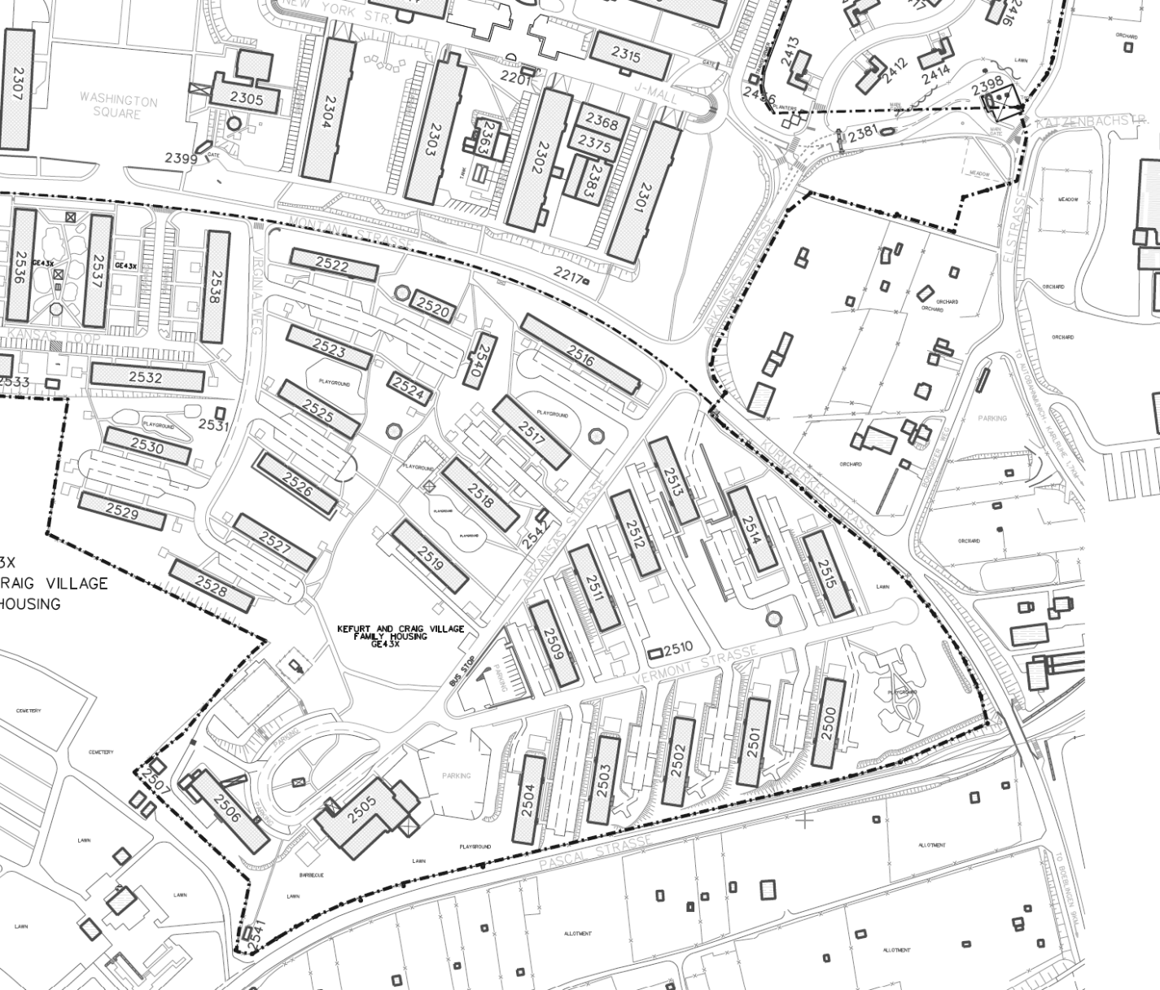
Patch Barracks- Gates (June – August 2026)
Main Gate:
- Inbound lanes (closed)
- Temporary outbound lane (open 24/7)
- No Pedestrian Access during the project
Main Gate
K & K Gate:
- 2 inbound lanes (0600-1545)
- 2 outbound lanes (1545-1800)
Pedestrian Access:
- Guard supported during the work week (0600-1800)
- Manual identity search (if necessary)
- Visitor Pass support
- Outside of these hours- support available at Panzer/ Kelley/ Robinson Barracks
Enhanced Security Pedestrian Gate (ESPG) – 24/7 (check MAPA for status)
K & K Gate
Swabian Gate
Swabian Gate:
- 4 inbound lanes
- 1 outbound lane
(RIGHT TURNS ONLY– Inbound and Outbound the Gate)
Pedestrian Access:
- 24/7 and Guard support
- No manual identity or visitor pass support
Three (3) Gates will be open on Patch Barracks from June – August:
Main Gate- Outbound/ Exit lane only
K & K Gate- 2 x lanes (Inbound in the morning/afternoon & Outbound in the evening (1545 – 1800))
Swabian Gate – 4 x Inbound lanes & 1 x Outbound lane (RIGHT TURNS ONLY– Inbound and Outbound the Gate)
LTC Daniel Jimenez / DES / DSN 314-596-3001 / daniel.jimenez6.mil@army.mil
CUI

Slide 4
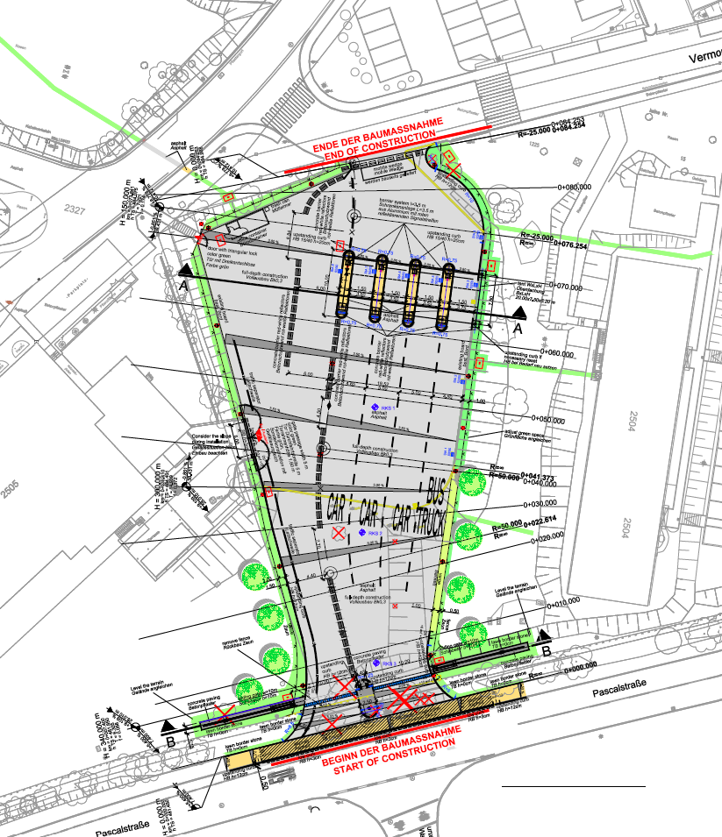
Swabian Gate
Gate Features:
June 2026 opening with basic gate features suitable for traffic and safety.
The gate allows for the necessary Patch Main Gate improvements from June-August.
(RIGHT TURNS ONLY– Inbound and Outbound the Gate)
Four (4) vehicle lanes to enter the gate.
Pedestrian access (24/7)- best suited for bicycles/ strollers.
Increased MP patrol presence for traffic enforcement.
24/7 Pedestrian Access
LTC Daniel Jimenez / DES / DSN 314-596-3001 / daniel.jimenez6.mil@army.mil

Slide 5
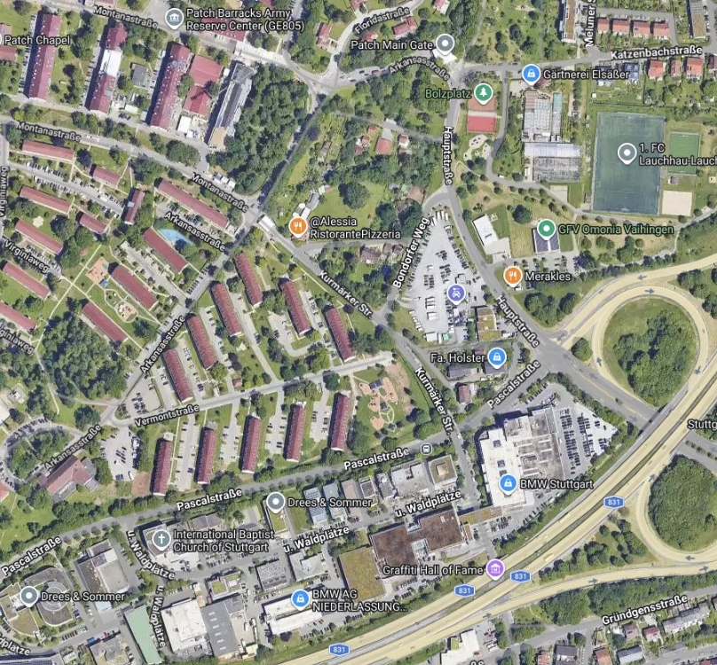
Traffic routes to Patch Barracks (June- August 2026)
From A831
Primary (Swabian Gate):
West on Pascalstrasse & turn right into the gate
Alternate (K & K Gate)
Right turn from the Autobahn to Haupstrasse,
Left to Bondorger Weg,
and Right to Kumarkerstrasse.
From Sindelfingen-Boblingen
K & K Gate
East on Pascalstrasse and at the traffic light turn left on to Haupstrasse,
Left to Bondorger Weg,
and Right to Kumarkerstrasse.
Prohibited/ Illegal to turn left on Pascalstrasee into the Swabian Gate
K & K Gate
Swabian Gate
Legend:
Swabian Gate route
K & K Gate route
LTC Daniel Jimenez / DES / DSN 314-596-3001 / daniel.jimenez6.mil@army.mil

Slide 6
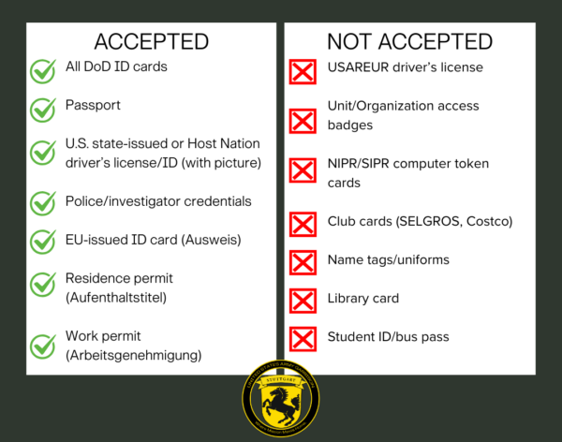
Gate Construction FAQs – ID Requirements
Q: Why do I need two forms of ID?
A: Entry at the alternate access control points requires two forms of photo identification as an enhanced security measure.
Q: What are the ID requirements for minors?
A: Adults with two forms of proper ID may escort children under the age of 12. Children 12-17 years old only require one form of ID.
Q: What do I do if I for lose or forget my CAC, or if I only have one form of ID?
A: Report lost CACs and DoD ID Cards to the MPs. If you forget your CAC, guards may not have access to do look-ups at Patch Barracks ACPs. Adults will not be able to enter Patch Barracks without the proper identifications or access.
Q: How can I sign my visitors in?
A: Visitor passes will be issued at the K & K Gate during duty hours (0600-1800). After duty hours and on weekends, you can obtain visitor passes can from the Visitor Centers on Panzer, Kelley, or Robison Barracks.
All adults must bring two forms of proper ID
to access Patch Barracks during the gate construction project.
LTC Daniel Jimenez / DES / DSN 314-596-3001 / daniel.jimenez6.mil@army.mil

Slide 7
Gate Construction FAQs – Pedestrian Safety
Q: With the closure of parking spots adjacent to Building 2517 for the staging of balconies and the rerouting of the gate traffic down Arkansas Str., there are concerns for the safety of children crossing the street in that area. What measures is the garrison taking to ensure the safety of pedestrians in this area?
The garrison will implement the following to increase safety in the vicinity of Arkansas Str.:
Increased signage along route.
DES will place additional Department of the Army Civilian Police and MP patrols, especially during peak traffic times, and a period of zero-tolerance enforcement implemented for failing to stop at crosswalks, speeding and other moving violations. They will be prepared to establish Traffic Control Points (TCPs) during peak periods to safely and efficiently move vehicles and pedestrians.
DES and the Safety Office will look for ways to reduce risks by continuously assess traffic flow; identifying physical hazards, like parked cars and trash receptacles; and implement mitigations to improve visibility and traffic flow as needed.
PAO and Safety will amplify a safety messaging campaign emphasizing vehicle and pedestrian safety. We will remind everyone that pedestrians must make eye contact with drivers to ensure the drivers see them and the vehicle has stopped prior to crossing any road.
Q: Can you assign MPs to direct crosswalk traffic?
A: No, crossing guards are not a law enforcement task or security task.
Q: Can you put a three-way stop sign at the intersection of Arkansas and Montana Str.?
A: DES and the Safety Office are evaluating the safety of this intersection.
Q: What is the plan for kids who walk to school from Vermont Str.?
A: The construction will begin after school is out of session. This will reduce the number of children walking in the area in the morning.
Safety is
a shared responsibility
LTC Daniel Jimenez / DES / DSN 314-596-3001 / daniel.jimenez6.mil@army.mil

