Slide 1
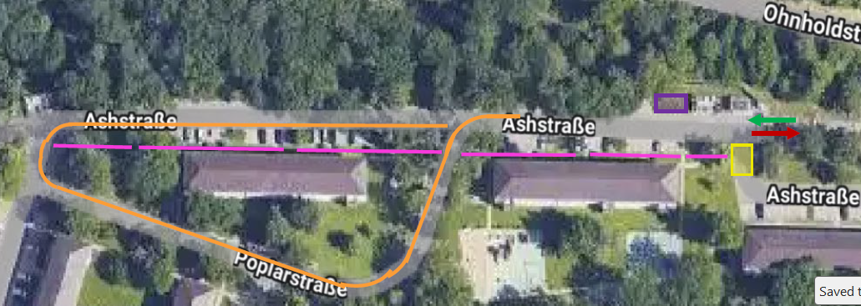
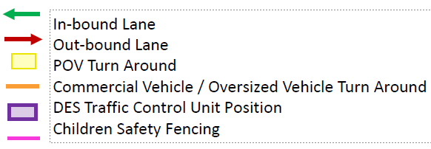
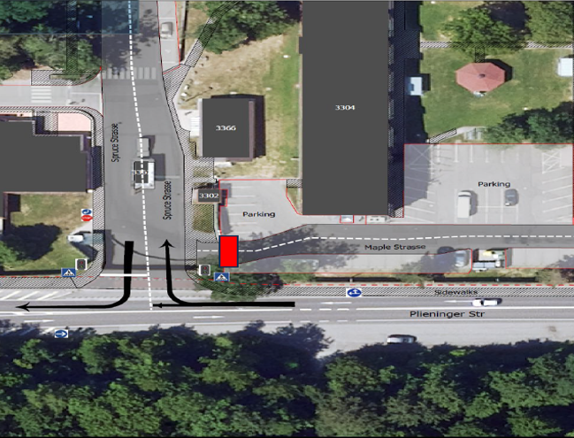
Kelley Barracks North and South Entry Control Points
UNCLASSIFIED
North Gate Operations Info
Residents will be able to access 24/7, inbound and outbound traffic.
Gate supports commercial traffic access.
Residents will have to sign guest at the front gate.
Residents must carry two forms of ID for Entry.
Pedestrian traffic must use the ESPGs (Pedestrian Gate) located at the Main Gate and South Gate.
Traffic must yield to pedestrian and school bus stop on Ash Strasse.
South Gate operations Info
Residents will be able to access 24/7, inbound and outbound traffic.
Gate supports commercial traffic access.
South Gate, inbound traffic restricted to right turn only
South Gate, outbound traffic restricted to right turn only.
Pedestrian traffic must use the ESPGs (Pedestrian Gate) located at Main Gate and South Gate.
Residents must carry two forms of ID for Entry.
All inbound and outbound traffic must yield to pedestrian and cyclist traffic in crosswalk.
No access to Maple Strasse at South Gate entrance.

Slide 2
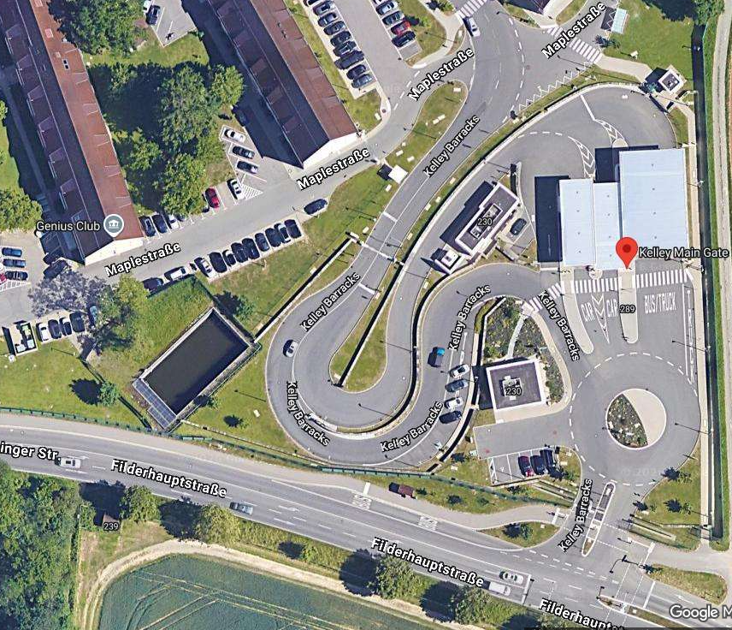







Kelley Barracks Project Main Entrance
UNCLASSIFIED
Residents will be required to sign in their visitors at the visitor center.
The duty bus will drop off and pick up at the main gate.
Pedestrian (ESPG) walk-in operational 24/7.
Construction equipment Lay down Site
Legend
Visitor center (BLDG 230)
Duty bus drop off and pick up
Pedestrian (ESPG) Walk-in gate operational 24/7

Slide 3
DES: Temporary Gate Access ID Requirements
UNCLASSIFIED
To enhance installation security and our force protection posture, USAG Stuttgart would like to remind you that all personnel must be prepared to present a secondary form of identification when requested by security personnel, in accordance with standing regulations AR 190-13, AEA 190-16, DoDM 5200.08.
Approved Forms of Identification
Please ensure you always carry one current and unexpired document from each of the following categories:
Primary Identification
Secondary Identification
ID Type | Details
U.S. DoD ID | US Military DoD ID Common Access Card (CAC) Armed Forces Identification Card (DD Form 2) U.S. Uniformed Services Identification & Privilege Card (DD Form 1173) 100% Disabled Veteran Card (DD Form 2765) Dependents of Retirees and 100% Disabled Veterans (DD Form 1173) Defense Biometric Identification System (DBIDS) Card
HN Police ID | Polizei Dienstausweis in Germany.
International Passport
NATO ID Card (Allied Command Operations (ACO) or Allied Command Transportation (ATC) Mission Identification System ID Card)
Host Nation Military Identification Card
Permanent Resident Card or Alien Registration Receipt Card (INS Form I-551).
U.S. or HN Driver’s license (must contain a photograph and biographic information).
Identification card issued by a U.S. Federal agency (must contain a photograph and biographic information).
U.S. Coast Guard Merchant Mariner Card or Transportation Worker Identification Credential (TWIC).
Guidelines for Dependent Children
  14 - 18 years old: Only required to present ONE ID - their Dependent ID card.
  13 years old and under: Not required to present any form of ID. Must be escorted by an adult (18+) who will vouch for the child.
Your cooperation and understanding of these requirements is essential and will help reduce wait times at all access control points. Be prepared by ensuring you have the required documents before arriving at an access control point.

Slide 4
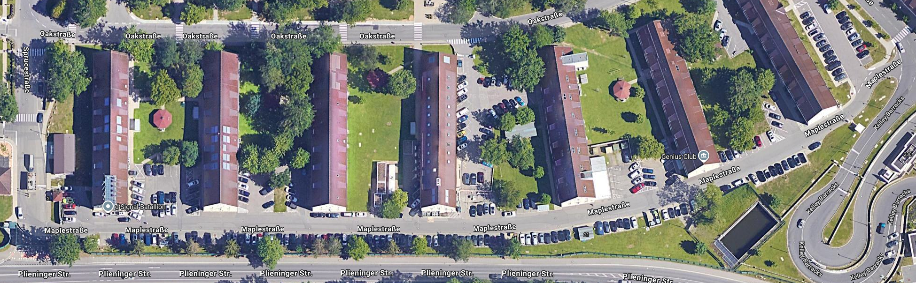
Kelley Barracks Barrier Project
The intersection of Maple Strasse and Spruce Strasse will be blocked off by Jersey barriers to restricting access from the south gate.
During construction Maple Strasse will be transitioned into a two-lane road to allow access to the available parking.
Jersey Barrier will be placed at the ends of building to deter unauthorized parking and allow traffic to flow correctly .

Slide 5
UNCLASSIFIED
Kelley Barracks Project additional notes
Kelley Barracks Alternate access control points will be open 24 /7 for the duration of the Main Gate project.
The Kelley North Gate and South Gate will be official open for Pedestrian, POVs and Commercial Vehicle Traffic.
Two Forms of Identification will be required at alternate gates for entry into Kelley Barracks.
Electronic Security Pedestrian Gates at Main Gate and South Gate only require CAC card for access.
Dependent Children 18 Years of age and under only require one form of ID.
Visitor Control Center will be open for pass issuance.
During Construction of the Final Denial Barrier Maple Strasse will be turned into the two-lane road to allow ease of access to the 3300 Series Building complexes.
No change to DoDEA school bus pick up or drop off.
Mikael Rumphrey, DES, 314-596-2045, mikael.a.rumphrey.civ@army.mil
CUI
Notes:
Traunch 1 (Project)- consisted of XXXX
Cost:
Traunch #1 – $1.5M (Just for the Patch Main ACP of traunch #1, including the modifications, and the Period of Performance (POP) extensions)
Traunch #2 – $2M
The only barrier of Stuttgart’s that was in the first round (FY26-FY30) of replacement by IMCOM was the MARFOR Gate’s FDB.

